Slide 1

Big Explorers Cycle A: Spring Term 2-
Making a Moving Book Tech 4 Write (Year 1 - Mechanisms)
Overview, Vocabulary and Sticky Knowledge
What do I already know about Mechanisms?
In Little Explorers, I learned…
How to make plans verbally for making.
How to join materials together using tape, glue or paper clips.
How to use scissors to cut materials.
How to describe a sliding mechanism, and how it could be put together.
In Big Explorers, I learned…
To follow a design brief
To carefully select materials based on their properties.
Challenging vocabulary.
Mechanism
Adapt
Assemble
Model template design design criteria sliders Input
Words to learn.
Words I should know.
Cut, join, shape, test
Key facts I will learn…
A mechanism is the parts of an object that move together.
A slider mechanism moves an object from side to side.
A slider mechanism has a slider, slots, guides and an object.
4) Bridges and guides are bits of card that purposefully restrict the movement of a slider.

Slide 2
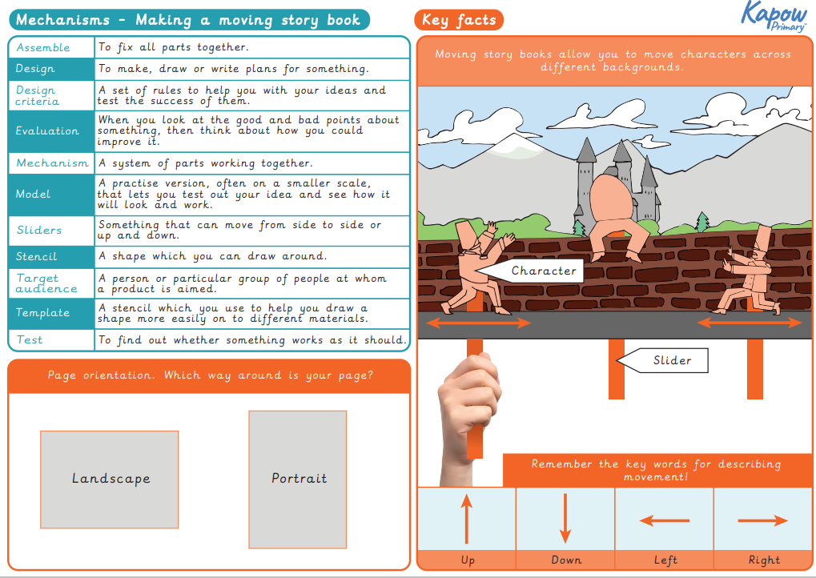

Slide 3
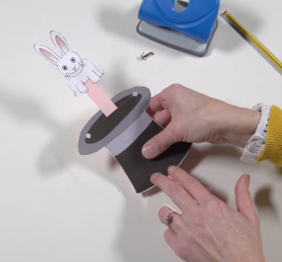
Design Brief
Making a Moving Book
Books can be so exciting, but even more exciting when there are moving parts!
You are going to make your own moving picture book.
Your book will need to include:
Characters that move up and down,
Characters that move left to right,
A slider mechanism.
Challenge: Could you use bridges and guides to control the movement of your slider mechanisms?
Can you make a sliding mechanism to move a character?
Can you create a template to test your mechanisms?
Can you assemble your mechanisms to make an exciting picture book?

Slide 4
Sticky knowledge
Use the sticky knowledge statements as part of your sticky learning starters each lesson.
A _______________ is something that can move up and down or left to right. Slider ball swing
2. A practice version of what you are going to make is called a ___________. First try model make
A _____________ is a system of moving parts working together. Slider mechanism model
A shape that you can draw around is called a ________________. Shape ruler stencil
To find out if something works as it should, we should ____________ it. Test make break
Bridges and guides are bits of cards that are purposely used to ___________ movement of a slider. Stop restrict slow
Mechanism, Chassis, Dowel, Axle, Axle holder.
Design, evaluate, equipment, diagram
Cut, join, shape, fix, tools, make, wheel.

