Slide 1

Big Explorers Year A Summer Term 1 and 2 – What makes some places sacred? (RE) Overview, Vocabulary and Sticky Knowledge
What do I already know?
In Little Explorers, I learned…
A special place is somewhere that makes us feel happy and safe.
Christians go to a church to pray to God.
A church sometimes has a stained-glass window which shows stories from the Bible.
Churches sometimes have a font to baptise children and adults. (Special places)
In Big Explorers, I learned…
A Muslim place of worship is called a mosque. There are special rules and rituals you need to follow when they are prayed in. (Muslims)
Key Vocabulary:
Challenging vocabulary.
Shahadah
Wudu
Reflection
Words to learn.
Torah Tenakh Imam
Prayer Mat Dome
Minaret Shahadah Calligraphy Chapel Cathedral
What will I now learn?
Places of worship are important to the local community and give reasons for your answers
Objects in a church and say how they are used and what they mean to believers.
Objects in a mosque and say how they are used and what they mean to believers
Objects in a synagogue and say how they are used and what they mean to believers
About an object that is used in worship, saying how it is used and how it shows what people believe
To ask appropriate and respectful questions of believers
Words I should know.
Sacred Holy Treat Respect Rules
Stained-glass window Mosque Muslim Jewish people Noah Mosque/Masjid Patterns Vicar Priest Church Safe

Slide 2
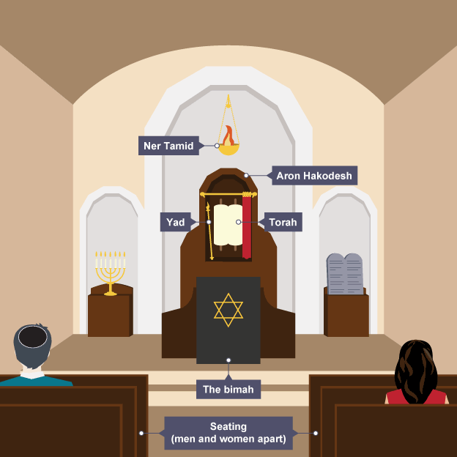
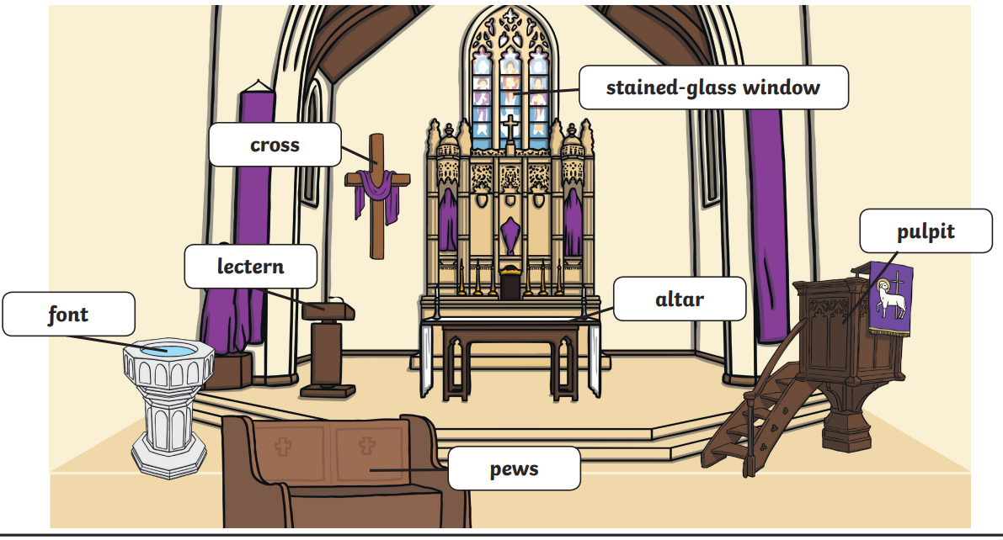
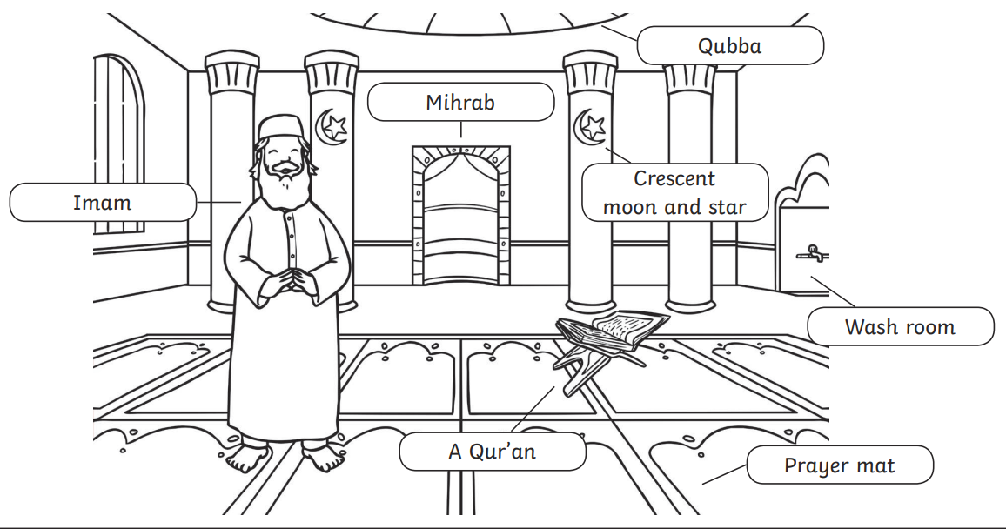
Sticky Knowledge:
A sacred place is somewhere you feel safe and can reflect.
A Christian place of worship can be a church, chapel or cathedral.
Muslims pray in a mosque.
Jewish people pray in a synagogue.
The inside of a church:
The inside of a Jewish synagogue.
The inside of a Muslim mosque.

