Slide 1

Big Explorers Year A Spring Term 2 – What does it mean to belong to a faith community? (RE) Overview, Vocabulary and Sticky Knowledge
What do I already know?
In Little Explorers, I learned…
Each person is individual and unique.
People have different religious beliefs and this is ok!
Christians believe God shows love for children through baptism. This is where children are blessed with Holy Water and candles are lit. (Belonging)
In Big Explorers, I learned…
A Muslim place of worship is called a mosque. There are special rules and rituals you need to follow when they are prayed in. (Muslims)
The Bible give different stories which Christians use to guide them and help to make good choices. (Christians)
Key Vocabulary:
Challenging vocabulary.
Ka’ba
Hajj
Geometric
Words to learn.
Rosary Font
White robe
Aqiqah Calligraphy
What will I now learn?
Symbols of belonging from their own experience
Symbols of belonging for Christians
Symbols of belonging for Muslims
Why symbols of belonging matter to believers
What happens at a traditional Christian infant baptism dedication and suggest what the actions and symbols mean
Two ways people show they belong to each other when they get
married
Examples of cooperation between different people
Words I should know.
Symbol Belonging Cross Crucifix
Baptism Christening Welcome Ceremony Vicar Holy Water Scales Gold
Marriage/Wedding Promises Rings

Slide 2
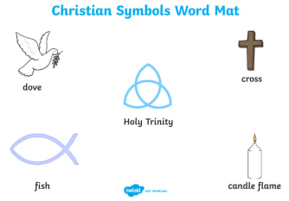
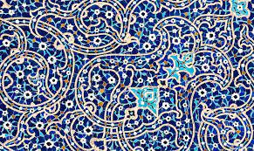
Sticky Knowledge:
Religions use symbols to show belonging: some Christians wear a cross or use the symbols of a fish.
Muslims believe that you should not show images of Allah or Mohammad as a sign as respect. They often use calligraphy and geometric patterns.
In the Islamic story of the Boy and the stones, the boy throws stones to collect dates from a tree. The man is angry, but explains the stones were damaging his tree. The boy apologises and the man forgives him.
Christian Baptisms involve using blessed water to clean and purify people. This welcomes them to the Christian faith.
Muslims do not baptize their children. Instea,d a ceremony involving whispering a prayer to the baby and giving them something sweet as well as choosing a name from the Quran is held.
Christians and Muslims believe that marriage is a promise you make to look after and care for one another.
An example of Islamic art.

