Slide 1

Big Explorers Year A Spring Term 1 – Who is a Muslim and what do they believe? (RE) Overview, Vocabulary and Sticky Knowledge
What do I already know?
In Little Explorers, I learned…
The Qur’an is the special book used by Muslims. (Special stories)
Religious stories teach us messages, such as in the Muslim story of the Thirsty Camel, we are taught to treat each other with kindness. (Special World)
In Big Explorers, I learned…
Christians believe that God is the Father of everyone. He looks after and guides us all.
The Bible is a collection of stories written by lots of people. It is split into two parts: The Old Testament and the New Testament.
The Bible give different stories which Christians use to guide them and help to make good choices.
Christians believe that Jesus is a real person, who is the Son of God. He told lots of stories (sermons) to teach people about right and wrong, and how they should behave with one another. (Christians)
Key Vocabulary:
Challenging vocabulary.
Calligraphy
Revelation
Angel Jibril
Words to learn.
Muhammad Prophet
Peace Be Upon Him (PBUH) Crescent 99 Names Mosque
Imam Prayer Mat Dome
Minaret Call to Prayer
What will I now learn?
Simple ideas about Muslim beliefs about God, making links with some of the 99 Names of Allah
A story about the life of the Prophet Muhammad
Objects used by Muslims and suggest why they are
important
Ways Muslims mark Ramadan and celebrate Eid-ul-Fitr and how this might make them feel
Examples of cooperation between people who are different
Words I should know.
Islam Muslim Allah Inspired Star Holy Teachings Beliefs Precious Qur’an

Slide 2
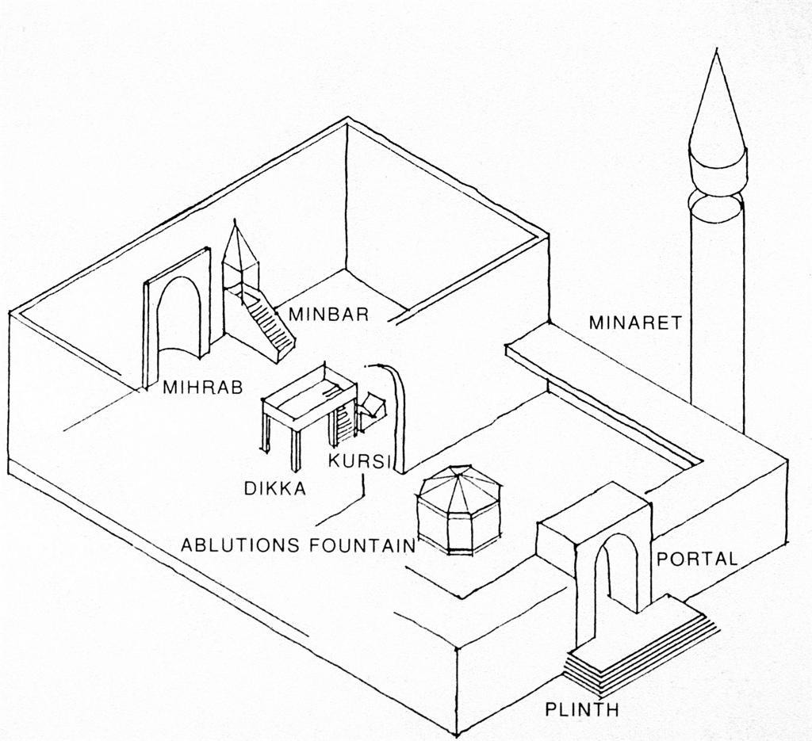
Sticky Knowledge:
Allah is the Muslim name for God. They believe Allah is the only God.
The Prophet Muhammad is such a special leader that he has over 1.5billion followers who respect him, all over the world. People have followed his teaching for over 1400 years! Because he is important to Muslims, they say ’Peace BE Upon Him’ after they say his name.
Muslims believe that Muhammad heard the voice of God (Allah), and spent his life passing on the teachings of him.
Muslims believe you should never draw an image of people or nature as you cannot make it as beautiful as Allah’s creation.
A Muslim place of worship is called a mosque. There are special rules and rituals you need to follow when they are prayed in.
A diagram of a Muslim mosque.

