Slide 1

Explorers Spring Term 2 –Powerful People
Overview, Vocabulary and Sticky Knowledge
What do I already know?
In Little Explorers, I learned…
We all belong to a family and they are all different. (Marvellous Me!)
The emergency services are made up of the groups of people who help us; Firefighters, Police and the Ambulance service. (Explore the Future)
The British Royal Family live in Buckingham Palace in London. (Explore Building)
Key Vocabulary
Challenging vocabulary.
Co-ordinates
Hemisphere Pioneer
Navigation
compass voyage adventurer Christopher Columbus continent
Santa Maria equator West Indies admiral rigging trade
crows nest Antarctica poles Crimea conflict athlete world record
What am I going to learn about this half term?
Who were some famous people of the
world?
How do / did explorers travel?
Who was Florence Nightingale and Mary Seacole? What did they do?
Where did Christopher Columbus discover?
Who was Falcon Scott and what did he do?
Why is Rebecca Adlington a person we look up to?
Words to learn.
Words I should understand.
ocean world explorer map discover crew north south east west ship sailor captain Sink float travel injury nurse sport

Slide 2
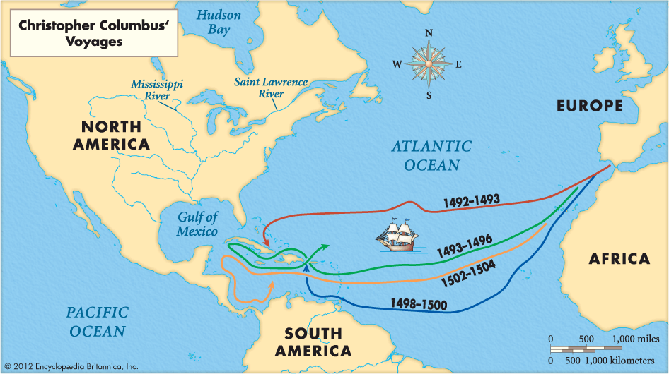
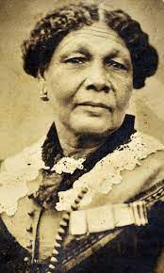
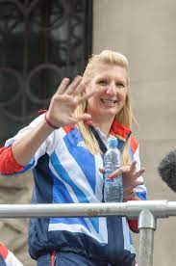
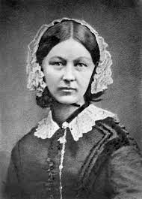
Sticky Knowledge
Florence Nightingale was a nurse and she saved the lives of many soldiers during the Crimean War. She became known as the Lady with the Lamp as she carried a lamp to check on her patients throughout the night.
Mary Seacole was a nurse and businesswoman who has become a key figure in Black History because of her amazing achievements - she's most famous for helping the sick and wounded in the Crimean War.
Christopher Columbus was an explorer, who is most known for discovering America, despite wanting to travel to China!
Captain Robert Falcon Scott was the first British explorer to reach the South Pole and explore Antarctica.
Rebecca Adlington is a famous athlete from Loughborough, most known for her swimming. She was the first woman to win swimming gold for Great Britain since 1960. She was the first British swimmer to win more than one gold medal at a single Olympic Games in recent years.
Rebecca Adlington
Florence Nightingale
Mary Seacole

